Slide 1
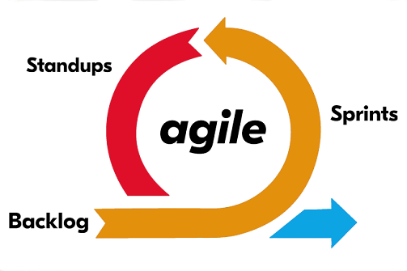


Software Engineering
(#2301CS405)
Unit-2 Agile Development
Prof. R. B. Gondaliya
Computer Engineering Department
rajkumar.gondaliya@darshan.ac.in
+91-9723232741

Slide 2
Agile Models
Section 1

Slide 3

Looping
Outline
Agile Software Development: Defining Agility
Agile Manifesto and Principles,
Agile Process
Extreme Programming,
Adaptive Software Development,
Scrum,
Dynamic System Development Method

Slide 4
Why Learn Agile?
learning Agile methodology and its complete concepts gain several significant advantages that prepare them for success in their future careers, particularly in industries like software development, project management, and product development.
Here are some key reasons why should learn Agile
Industry Relevance and Demand
High Demand
Career Opportunities
Enhanced Team Collaboration Skills
Teamwork
Role Understanding
Improved Project Management Skills
Iterative Approach
Time Management
Preparation for Certification
Professional Certification
Certified ScrumMaster (CSM),
Certified Scrum Product Owner (CSPO), etc.
Adaptability and Flexibility
Responding to Change
Continuous Improvement
Customer-Centric Mindset
Customer Collaboration
User-Focused Development

Slide 5

Introduction
Principles, patterns, and practices are important, but it’s the people that make them work
Process and technology are a second-order effect on the outcome of a project. The first-order effect is the people.
We can't manage programming teams like systems made of process-driven components.
People are not “plug-compatible programming units”.
If our projects are to succeed, we are going to have to build collaborative and self-organizing teams.
Those companies that encourage the formation of such teams will have a huge competitive advantage over those who hold the view that a software-development organization is nothing more than a pile of twisty little people all alike.
A cohesive software team is the most powerful software development force there is.

Slide 6

The Genesis of Agile Cont.
The weather-cock on the church spire, though made of iron, would soon be broken by the storm-wind if it did not understand the noble art of turning to every wind.
Many of us have experienced or heard of a project with no practice to guide it.
The lack of effective practices leads to unpredictability, repeated error, and wasted effort.
Customers are disappointed by slipping schedules, growing budgets, and poor quality.
Developers are disheartened by working ever longer hours to produce ever poorer software.
Once we have experienced such a fiasco, we become afraid of repeating the experience.
Our fears motivate us to create a process that constrains our activities and demands certain outputs.
We draw these constraints and outputs from past experience, choosing things that appeared to work well in previous projects.
Our hope is that they will work again and take away our fears.

Slide 7
Agile Practices
However, projects are not so simple that a few constraints and artifacts can reliably prevent error.
As errors continue to be made, we diagnose those errors and put in place even more constraints and artifacts to prevent those errors in the future.
After many projects we may find ourselves overloaded with a huge cumbersome (heavy/difficult) process that greatly holds up our ability to get anything done.
A big cumbersome process
slow the team to the extent that schedules slip and budgets bloat
reduce responsiveness of the team to the point where they are always creating the wrong product.
In 2000 A.D.
there were still many teams operating without a process
the adoption of very large, heavyweight processes is rapidly growing, especially in large corporations

Slide 8
Agile Practices Cont.
In early 2001, motivated by the observation that software teams in many corporations were stuck in a complex situation of ever-increasing process
A group of industry experts met to outline the values and principles that would allow software teams to work quickly and respond to change
They called themselves the Agile Alliance. They worked to create a statement of values. The result was The Manifesto of the Agile Alliance

Slide 9




The Manifesto of the Agile Alliance
Manifesto for Agile Software Development
We are uncovering better ways of developing software by doing it and helping others do it.
Through this work we have come to value:
Individuals and interactions
over
processes and tools
Working
software
over comprehensive documentation
Customer collaboration
over
contract negotiation
Responding
to change
over
following
a plan

Slide 10

Individuals and interactions over processes and tools
People are the most important ingredient of success.
A good process will not save the project from failure if the team doesn’t have strong players, but a bad process can make even the strongest of players ineffective.
Even a group of strong players can fail badly if they don’t work as a team.
A strong player is not necessarily a pro programmer. A strong player may be an average programmer, but someone who works well with others.
Working well with others, communicating, and interacting, is more important than raw programming talent.
A team of average programmers who communicate well is more likely to succeed than a group of superstars who fail to interact as a team.
The right tools can be very important to success.
Compilers, IDEs, source-code control systems, etc. are all vital to the proper functioning of a team of developers.

Slide 11
Individuals and interactions over processes and tools
Remember, building the team is more important than building the environment.
Many teams and managers make the mistake of building the environment first and expecting the team to gel(fit together well) automatically.
Instead, work to create the team, and then let the team configure the environment on the basis of need.

Slide 12
Working software over comprehensive documentation
In the past, software developers would spend countless hours making comprehensive records.
It was also before they began to write a single code line.
Even though documentation is not wrong, you must concentrate on delivering working software to your customers.
The Agile Manifesto makes shipping software for your customers one of the main focuses. You can then collect reviews to enhance upcoming releases.
Software without documentation is a disaster.
Code is not the ideal medium for communicating the structure of a system.
The team needs to produce human-readable documents that describe the system and the rationale for their design decisions.

Slide 13
Working software over comprehensive documentation
However, too much documentation is worse than too little.
Huge software documents take a great deal of time to produce and even more time to keep in sync with the code.
If they are not kept in sync, then they turn into large, complicated lies and become a significant source of misdirection.
The document needs to be short and significant.
Short means one or two dozen pages at most
Significant means it should discuss the overall design rationale and only the highest-level structures in the system
There is a simple rule called Martin’s first law of documentation that prevents it:
Produce no document unless its need is immediate and significant

Slide 14

Customer collaboration over contract negotiation
According to the Agile Manifesto, the focus should be on continuous development. You need to build a feedback loop with your customers so that you can constantly ensure that your product works for them
Software cannot be ordered like a commodity.
You cannot write a description of the software you want and then have someone develop it on a fixed schedule for a fixed price.
Time and time again, attempts to treat software projects in this manner have failed
Successful projects involve customer feedback on a regular and frequent basis. Rather than depending on a contract or a statement of work, the customer of the software works closely with the development team, providing frequent feedback on their efforts.
The best contracts are those that govern the way the development team and the customer will work together.

Slide 15
Responding to change over following a plan.
We can not imagine a time when we would create a roadmap and it would never changes
The issue with static roadmaps is that we don’t live in a static world. Needs and requirements are always shifting, and priorities are always changing. That static roadmap will soon grow outdated.
It is the ability to respond to change that often decides the success or failure of a software project.
When we build plans, we need to make sure that our plans are flexible and ready to adapt to changes in the business and technology.
That’s why the Agile Manifesto suggests that a software team should have the ability to pivot and change direction whenever they need to, with a flexible roadmap that reflects that. A dynamic roadmap can change from quarter to quarter, sometimes even month to month, and agile teams are able to keep up with those changes.

Slide 16
Agility
Agility is ability to move quickly and easily.
It is a property consisting of quickness, lightness, & ease of movement.
The ability to create and respond to change in order to profit in a unstable global business environment.
The ability to quickly reprioritize use of resources when requirements, technology, and knowledge shift.
A very fast response to sudden market changes and emerging threats by intensive customer interaction.
Use of evolutionary, incremental, and iterative delivery to converge on an optimal customer solution.
Maximizing BUSINESS VALUE with right sized, just- enough, and just-in-time processes and documentation.

Slide 17


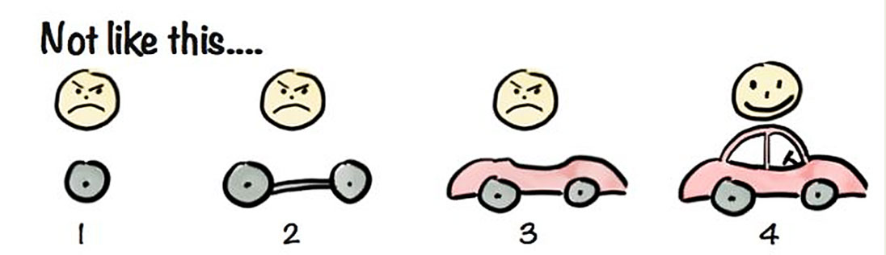

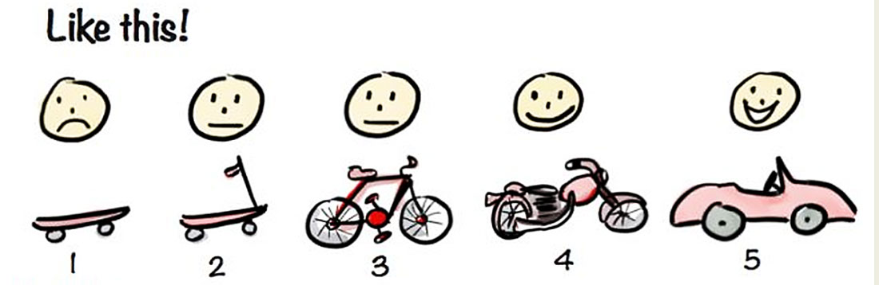

What is Agility? Cont.
Current Functionality
Rapid and Incremental delivery of software
Effective
response
to change
Change Request
Organizing a team
so that it is in control to perform
the work
Effective
communication
among all
stakeholders
Development
Team
Drawing the
customer onto
the team
Eliminate the
“us and them”
attitude
Customer

Slide 18
Agile Process
Agile software process addresses few assumptions
Difficulty in predicting changes of requirements and customer priorities.
For many types of software; design and construction are interleaved (mixed).
Analysis, design, construction and testing are not as predictable as we might like.
An agile process must adapt incrementally.
To accomplish incremental adaptation, an agile team requires customer feedback (so that the appropriate adaptations can be made).

Slide 19



Agility Principles
Highest priority is to satisfy the customer through early & continuous delivery of software
The sponsors, developers, and users should be able to maintain a constant pace indefinitely.
Welcome changing requirements
Deliver working software frequently
Business people and developers must work together
Build projects around motivated individuals
Emphasize face-to-face conversation
Working software is the measure of progress
Continuous attention to technical excellence and good design
Simplicity – the art of maximizing the amount of work done
The best designs emerge from self-organizing teams
The team tunes and adjusts its behavior to become more effective

Slide 20
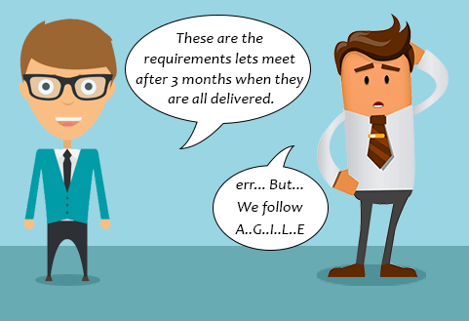
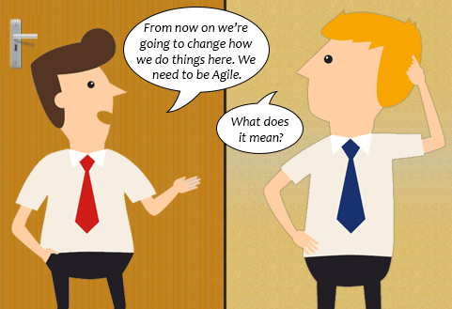

Where agile methodology not work
Project plan & requirements are clear & unlikely to change
Unclear understanding of Agile Approach among Teams
Big Enterprises where team collaboration is tough

Slide 21
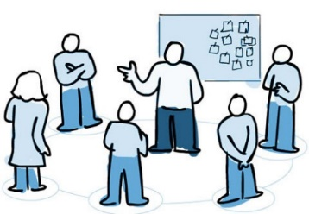


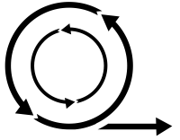
Agile Process Models
Extreme Programming (XP)
Scrum
Adaptive Software Development (ASD)
Dynamic Systems Development Method (DSDM)
Feature Driven Development (FDD)

Slide 22
Extreme Programming (XP)
The most widely used approach to agile software development
A variant of XP called Industrial XP (IXP) has been proposed to target process for large organizations
It uses object oriented approach as its preferred development model
XP Values
Communication: To achieve effective communication, it emphasized close & informal (verbal) collaboration between customers and developers
Simplicity: It restricts developers to design for immediate needs, not for future needs
Feedback: It is derived from three sources the implemented software, the customer, and other software team members, it uses Unit testing as primary testing
Courage: It demands courage (discipline), there is often significant pressure to design for future requirements, XP team must have the discipline (courage) to design for today
Respect: XP team respect among members

Slide 23
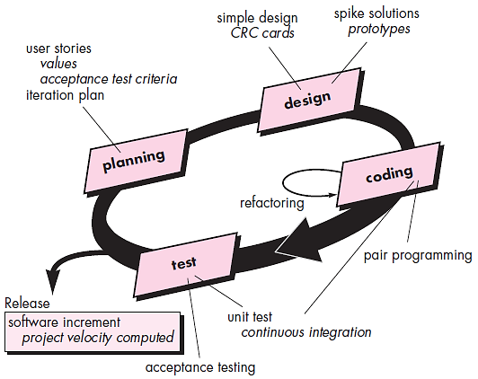
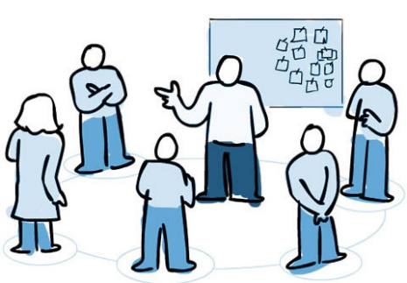
The XP Process
It considers four framework activities
Planning
1. Planning  2. Design  3. Coding  4. Testing
User Stories
Customers assigns value (priority)
Developers assigns cost (number of development weeks)
Project velocity
Computed at the end of first release
Number of stories implemented in first release
Estimates for future release
Guard against over-commitment

Slide 24
User story examples
User story examples for login
ID | Story | Estimation | Priority
1 | As a user, I want an option to stay logged in, so that I don’t have to enter my credentials every time. | 3 | 1
2 | As a user, I want to be able to reset my password if I forget it, so that I can regain access to my account. | 1 | 2
3 | As a user, I want to see an error message if I enter incorrect login details, so that I know when my login attempt has failed. | 1 | 3
User story examples for online shopping
ID | Story | Estimation | Priority
1 | As a customer, I want to track my order, so I can know when to expect delivery. | 1 | 2
2 | As an eco-conscious shopper, I want to see environmental impact details for products, so I can make sustainable choices. | 3 | 1
3 | As an online shopper, I want the ability to save products that I’m interested in for later, so I don’t have to search for them again. | 2 | 3

Slide 25
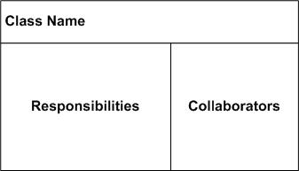

The XP Process cont.
Design
CRC card
Keep-it-Simple (Design of extra functionality is discouraged)
Preparation of CRC card is work project
CRC cards identify and organize object oriented classes
Spike Solutions (in case of difficult design problem is encountered)
Operational prototype intended to clear confusion
Refactoring
Modify internals of code, No observable change
Coding
Develops a series of Unit test for stories included in current release
Complete code perform unit-test to get immediate feedback
XP recommend pair-programming, “Two heads are better than one”
Integrate code with other team members, this “continuous integration” helps to avoid compatibility & interfacing problems, “smoke testing” environment to uncover errors early
Testing
Unit test by developers & fix small problems
Acceptance tests - Specified by customer
This encourages regression testing strategy whenever code is modified

Slide 26
CRC(Class-Responsibility-Collaboration) Card for Library
Class: Book
Class: Borrower
Responsibility | Collaboration
Know due date
Know its title
Know its author
Know its registration code
Responsibility | Collaboration
Know its name
Keep track of borrowed book
Keep track of overdue fines
Borrows book | Book
Class: Librarian
Responsibility | Collaboration
Check in book | Book
Check out book | Book, Borrower
Search book | Book
Know all borrower | Borrower

Slide 27
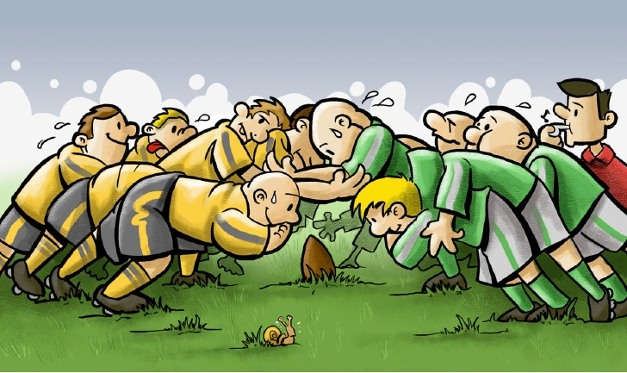



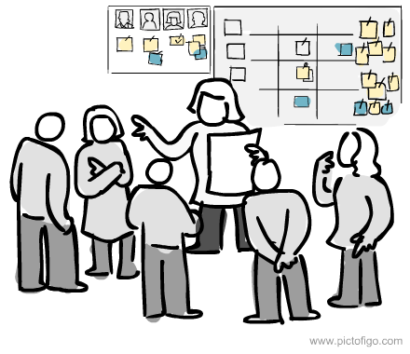
What is Scrum?
Scrum is an agile process model which is used for developing the complex software systems.
It is a lightweight process framework.
Lightweight means the overhead of the process is kept as small as possible in order to maximize the productivity.
Product Backlog
Product Owner
Product
A scrum is a method of restarting play in rugby that involves players packing closely together with their heads down and attempting to gain possession of the ball.
Daily Scrum Meeting
Sprint

Slide 28

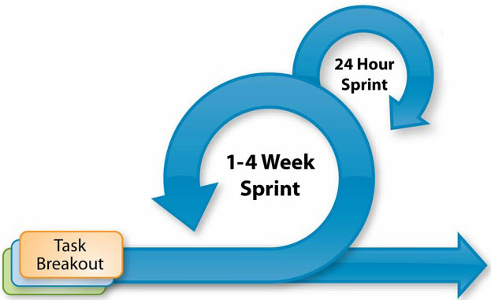





Scrum framework at a glance
Inputs from Customers, Team, Managers
Team Selects starting at top as much as it can commit to deliver by end of sprint
Scrum Master
Daily Scrum Meetings
Sprint Review
Product Owner
Finished Work
Product Backlog
Sprint Planning Meeting
Sprint Backlog
Sprint end date and team deliverable do not change
Sprint Retrospective
Prioritized list of what is required: features, bugs to fix...

Slide 29

Scrum cont.
Backlog
It is a prioritized list of project requirements or features that must be provided to the customer.
The items can be included in the backlog at any time.
The product manager analyses this list and updates the priorities as per the requirements.
Sprint
These are the work units that are needed to achieve the requirements mentioned in the backlogs.
Typically the sprints have fixed duration or time box (of 2 to 4 weeks, 30 days).
Change are not introduced during the sprint.
Thus sprints allow the team members to work in stable and short-term environment

Slide 30
Scrum cont.
Scrum Meetings
There are 15 minutes daily meetings to report the completed activities, obstacles (difficulty) and plan for next activities.
Following are three questions that are mainly discussed during the meetings.
What are the tasks done since last meeting ?
What are the issues that team is facing ?
What are the next activities that are planned?
The scrum master leads the meeting and analyses the response of each team member.
Scrum meeting helps the team to uncover potential problems as early as possible
It leads to “knowledge socialization” & promotes “self-organizing team structure”
Demo
Deliver software increment to customer
Implemented functionalities are demonstrated to the customer

Slide 31
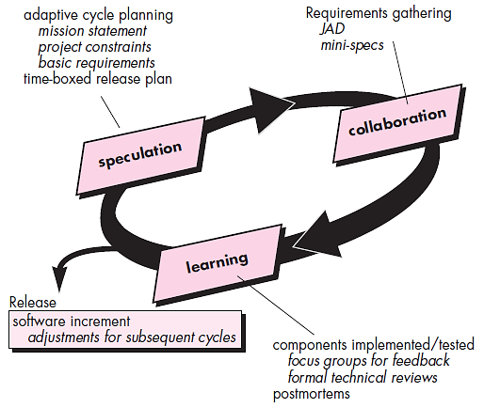
Adaptive Software development (ASD)
This is a technique for building complex software systems using iterative approach.
ASD focus on working in collaboration and team self-organization.
ASD incorporates three phases
Speculation
1. Speculation, 2. Collaboration & 3. Learning
The adaptive cycle planning is conducted.
In this cycle planning mainly three types of information is used
Customer’s mission statement
Project constraints
(Delivery date, budgets etc…)
Basic requirements of the project

Slide 32
Adaptive Software development (ASD) cont.
Collaboration
Learning
In this, collaboration among the members of development team is a key factor.
For successful collaboration and coordination it is necessary to have following qualities in every individual
Emphasize is on learning new skills and techniques.
There are three ways by which the team members learn
Focus groups
The feedback from the end-users is obtained.
Assist each other without resentment (offense)
Formal technical review
This review is conducted for better quality.
Work hard
Posses the required skill set
Postmortems
Team analyses its own performance and makes appropriate improvements.
Communicate problems and help each other
Criticize without any hate

Slide 33
Dynamic Systems Development Methods (DSDM)
Various phases of this life cycle model
Feasibility study: By analysing the business requirements and constraints the viability of the application is determined
Business study: The functional and informational requirements are identified and then the business value of the application is determined
Functional model iteration: It produces a collection of progressive prototypes that demonstrate practicality for the client.
Design and build iteration: If possible design and build activities can be carried out in parallel
Implementation: The software increment is placed in the working environment

Slide 34
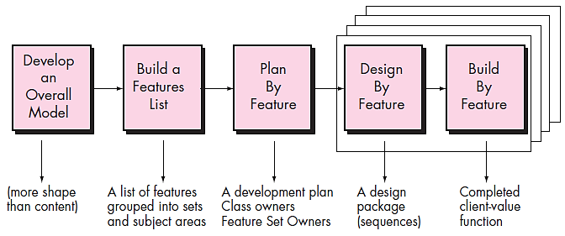
Feature Driven Development (FDD)
It is practical process model for object oriented software engineering
In FDD, the feature means client valued function.

Slide 35
Feature Driven Development (FDD) cont.
1. Develop overall model
Design by feature
The high-level walkthrough of scope and detailed domain walkthrough are conducted to create overall models.
For each feature the sequence diagram is created
Build by feature
2. Build feature list
Finally the class owner develop the actual code for their classes
List of features is created and expressed in the following form
<action> the <result> <by for of to> a(n) <object>
For Ex. “Display product-specifications of the product”
3. Plan by feature
After completing the feature list the development plan is created

Slide 36
Traditional vs. Agile Software Development
 | Traditional | Agile
Requirements | Clear Initial requirement and low change rate | Unclear requirement, creative, innovative,
Focus | Process | People
Testing Approach | Sequential (Post-Development) | Concurrent with Development
Organizational Structure | Linear | Iterative
Customer Involvement | Limited | Always Involved
Documentation | Complete | Only when necessary
Developers | They work individually within team | Collaborative or in Pair
Product Characteristic | All Included | Most Important first

Slide 37
Agile Scrum Framework
Section 2

Slide 38

Looping
Outline
Introduction to Scrum
Project Phases
Agile Estimation
Planning Game
Product Backlog & Sprint Backlog
Iteration Planning
User Story Definition, Characteristics and Content of User Stories
Acceptance Tests and Verifying Stories
Project Velocity
Burn Down Chart
Sprint Planning and Retrospective
Daily Scrum, Scrum Roles, Product Owner, Scrum Master, Scrum Team, Scrum case study,
Tools for Agile Project Management

Slide 39
Introduction to Scrum
Scrum is one of the Agile frameworks followed to complete challenging projects wherein there are dynamic changes in the requirements by using one or more cross-functional, self-organizing teams of about 7 +/- 2 people on each team.
Scrum consists of 3 roles: Product Owner, Scrum Master, and Development Team.
Scrum uses fixed-length iterations called sprints ranging from one week to four weeks (or 30 days long)
Scrum teams should consist of 7 +/- 2 people
Sprint is time bound & it cannot exceed more than 30 days
Scrum team aims to build a potentially shippable product by end of each sprint
Daily Scrum / Stand-up meeting should be only for 15 mins, and as the name goes, the team should be standing during the entire meeting time

Slide 40

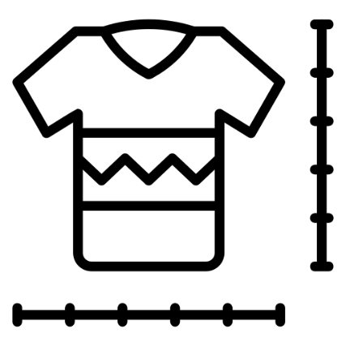
Agile Estimation
It’s nowhere a rule saying you have to adopt one of the techniques to estimate.
The team can use any logic to estimate their user stories.
Once the team has worked for awhile in Agile projects, their ability to estimate the user stories becomes much better and more accurate.
But teams new to Agile sometimes face difficulty in estimating the points for the user stories.
Below are the few estimation techniques, which can be used to estimate the user stories accordingly:
Planning Poker
T-Shirt Sizes

Slide 41


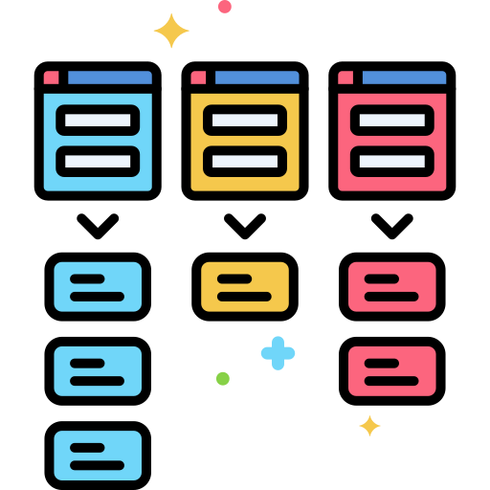
What is Planning Poker?
Planning Poker is a collaborative story estimating technique.
The agile team uses Planning Poker to estimate the product backlogs.
Story points, ideal days, or other estimating units can be used for Planning Poker.
Product Backlogs
Poker Cards
5
User Stories
0
1
2
1
5
The team member select the card to estimate Story
3
5
8
13
21

Slide 42
What is Planning Poker?
It starts with planning session, the product owner or customer reads an agile user story or describes a feature to the team member.
Each team member is holding a deck of Planning Poker cards with values 0, 1, 2, 3, 5, 8, 13, and 21 (Generally Fibonacci sequence)
The poker card values represent
the number of story points,
ideal days, or
other units in which the team estimates.
The team member discuss the feature, asking questions to the product owner as needed.
After the completion of the discussion, each team member selects one card to represent his or her estimate.
All cards are then disclosed at the same time.

Slide 43
Planning Poker estimation Cont.
If all the team members have selected the same value, that becomes the estimate.
If not, the team members discuss their estimates, the high and low estimators should especially share their reasons.
Experts with detailed knowledge will discuss with the team why a certain story is much easier/more difficult than it first appears.
After the discussion, each team member reselects an estimate card, and all cards are again disclosed at the same time.
This poker planning process is repeated until the final vote (value) is achieved.
Then the team will come to an agreement on the estimate for that user story and conclude on that.

Slide 44






T-Shirt Sizes Estimation
1 - 3
5 - 8
13 - 20
40 - 50
50+
1
1
3
5
7
6
13
15
20
40
45
45
50
50
60
2
3
1
6
5
6
18
20
20
55
Product Backlog

Slide 45
T-Shirt Sizes Estimation Cont.
At times it happens that the team members start aligning the story points with the hours of effort, which can create confusion.
To avoid this, it may be more effective to switch to a non-numeric estimation technique.
In the T-Shirt Sizing, the team is asked to estimate the story effort in terms of extra-small, small, medium, large, extra large, or double extra-large.
The sizes can, if necessary, be given numerical value after the estimation is finished.
By removing the numeric concept, team will be free to think in more abstract way.
The main problem with this method is that non-numerical scales are usually less detailed.
The T-Shirt Sizes method of estimates will be good for the teams just starting with Agile projects.
Eventually it’s a good idea to move toward the numeric method of estimation.

Slide 46
T-Shirt Sizes Estimation Cont.
Steps of T-Shirt Sizing Estimation
Make S, M, L, XL Cards
Product Owner will explain the story to be estimated and the development team will ask questions if they have any issues or unclarity.
Each developer gives each story a t-shirt size.
All in Development team will raise their cards simultaneously.
The development team will discuss the differences.
The product owner explains the story further or clarifies misunderstanding if any.
The team will Go back to Step 3-Step5 until all are agree with one size.
Complete or place the stories in size buckets.
Estimate the time to complete all stories in S, M, L, XL buckets.

Slide 47
T-Shirt Sizes Estimation Cont.
Benefits of T-Shirt Sizing Estimation
This is a very informal strategy and can be utilized quickly with a large number of items.
It is a popular agile relative estimation technique.
Forcing the estimate into one of a fixed set of sizes allows the process to go quickly
It is a good way to Introduce terms to relative estimating.
It is very effective for equality estimating
T-shirt sizes can be a great way to becoming familiar with relative estimating.
But However, insignificantly put some fundamental numbers on them (e.g., Medium=5) and after that steadily shift to using the numbers directly.

Slide 48




Scrum Roles and Responsibilities
The roles in Scrum are quite different from the traditional software methods. Clearly defined roles and expectations help individuals perform their tasks efficiently. In Scrum, there are three roles:
Product owner
Scrum Master
Development Team
The product owner maximizes the value the product creates.
The scrum master offers process and method coaching to the product owner, developers, and stakeholders.
The development team creates products that offer a great user experience and have the right quality

Slide 49

Product owner - Scrum Roles and Responsibilities
A product owner makes sure the Scrum team is aligned with the goals of the overall product that the team is developing.
He understands the business needs of the product, like customer expectations, and market trends.
Because he has to understand how the Scrum team fits into bigger picture goals, product owners usually stay in touch with product managers and other stakeholders outside the team.
Responsibilities of Product Owner:
Manage the product backlog by ordering work by priority
Set the product vision for the team
Communicate with external stakeholders and translate their needs to the team
Make sure the team is focused on hitting product needs through communication and evaluating progress
He provides clarification on the user story to the development team whenever needed
He releases burn-down charts

Slide 50

Scrum Master - Scrum Roles and Responsibilities
He is a facilitator of the Scrum process
He makes sure that a Scrum team is operating as effectively as possible with Scrum values.
He keeps the team on track, plan and lead meetings, and work out any obstacles the team might face.
He helps to incorporate Scrum concepts into the organization.
He is a leader and a behind-the-scenes supporter, he is also known as the “servant leader” of the Scrum team.
Has no management authority for the team (for example, he or she cannot command the team to do a specific task).
Only person who can take the issues or request to the top management.

Slide 51
Scrum Master - Scrum Roles and Responsibilities Cont.
Responsibilities of the Scrum Master
Shields the team from external interferences and distractions
Creates a positive environment for the team to be self-organizing.
Facilitate daily Scrum meetings (also called “daily standups”)
Lead sprint planning meetings
Conduct “retrospective” reviews to see what went well and what can be improved for the following sprint
Manage obstacles that arise for the team by communicating with stakeholders outside of the team

Slide 52

Development Team - Scrum Roles and Responsibilities
Development team is a self-organizing and cross-functional team (consists of the members with testing, development, business analyst, domain expertise, etc., skills).
The team should self-manage the tasks among the team.
The team should resolve people management issues if any among the team and should only take it to Scrum Master if it has gone out of the team’s control.
The team members usually collaborate to map out goals and plans for achieving them without waiting for orders
The team work with product owner in reprioritizing the product backlog items.
The team consists of 7+/- 2 members.
The team is responsible to complete the committed task for the sprint.
Responsibilities of Scrum Development Team:
Help in sprint planning and goal setting
Lend expertise to program, design, or improve products
Test products and prototypes, plus other forms of quality assurance

Slide 53
The scrum Phases
1
Initiate
2
Plan and Estimate
4
Review and Retrospect
1
Create Project Vision
7
Create User Stories
15
Convene Scrum of Scrums
2
Identify Scrum Master and Stakeholder(s)
8
Approve, Estimate, and Commit User Stories
16
Demonstrate and Validate Sprint
3
Form Scrum Team
9
Create Tasks
17
Retrospect Sprint
4
Develop Epic(s)
10
Estimate Tasks
5
Release
5
Create Prioritized Product Backlog
11
Create Sprint Backlog
18
Ship Deliverables
3
Implement
19
Retrospect Project
6
Conduct Release Planning
12
Create Deliverables
13
Conduct Daily Standup
14
Groom Prioritized Product Backlog
Notes:
https://www.scrumstudy.com/whyscrum/scrum-phases-and-processes
https://www.indeed.com/career-advice/career-development/scrum-phases

Slide 54
1. Initiate: the scrum Phases Cont.
Create Project Vision
In this process, the Project Business Case is reviewed to create a Project Vision Statement.
It provide focus for the entire project.
During this process Product Owner is identified.
Identify Scrum Master and Stakeholder(s)
In this process, the Scrum Master and Stakeholders are identified using specific Selection Criteria.
Form Scrum Team
In this process, Scrum Team members are identified.
Normally the Product Owner has the primary responsibility of selecting team members, but often does so in collaboration with the Scrum Master.
Develop Epic(s)
An epic is a large body of work that can be broken down into a number of smaller stories.
In this process, the Project Vision Statement serves as the basis for developing Epics.

Slide 55
1. Initiate: the scrum Phases Cont.
Create Prioritized Product Backlog
Epic(s) are refined, elaborated, and then prioritized to create a Prioritized Product Backlog for the project.
The Done Criteria is also established at this point.
Conduct Release Planning
The Scrum Core Team reviews the User Stories in the Prioritized Product Backlog to develop a Release Planning Schedule, which is essentially a phased deployment schedule that can be shared with the project stakeholders.
Length of Sprint is also determined in this process.

Slide 56
2. Plan and Estimate: the scrum Phases
Create User Stories
In this process, User Stories and their related User Story Acceptance Criteria are created.
User Stories are usually written by the Product Owner and are designed to ensure that the customer's requirements are clearly depicted and can be fully understood by all stakeholders.
The Scrum Team members are creating the User Stories.
User Stories are incorporated into the Prioritized Product Backlog.
Approve, Estimate, and Commit User Stories
In this process, the Product Owner approves User Stories for a Sprint.
Then, the Scrum Master and Scrum Team estimate the effort required to develop the functionality described in each User Story, and the Scrum Team commits to deliver the customer requirements in the form of Approved, Estimated, and Committed User Stories.

Slide 57
2. Plan and Estimate: the scrum Phases Cont.
Create Tasks
In this process, the Approved, Estimated, and Committed User Stories are broken down into specific tasks and compiled into a Task List.
Estimate Tasks
In this process, the Scrum Core Team, in Task Estimation Meetings, estimate the effort required to accomplish each task in the Task List.
Create Sprint Backlog
In this process, the Scrum Core Team holds Sprint Planning Meetings where the group creates a Sprint Backlog containing all tasks to be completed in the Sprint.

Slide 58
3. Implement: the scrum Phases
Create Deliverables
In this process, the Scrum Team works on the tasks in the Sprint Backlog to create Sprint Deliverables.
A Scrum board is often used to track the work and activities being carried out.
Issues or problems being faced by the Scrum Team could be updated in a Hurdle Log.
Conduct Daily Standup
Everyday a highly focused, Time-boxed meeting is conducted referred to as the Daily Standup Meeting.
This is the forum for the Scrum Team to update each other on their progress and any Hurdle they may be facing.
Groom Prioritized Product Backlog
In this process, the Prioritized Product Backlog is continuously updated and maintained.
A Prioritized Product Backlog Review Meeting may be held, in which any changes or updates to the backlog are discussed and incorporated into the Prioritized Product Backlog as appropriate.

Slide 59
4. Review and Retrospect - the scrum Phases
This phase is concerned with reviewing the deliverables
Convene Scrum of Scrums
Scrum Team representatives convene for Scrum of Scrums (SoS) Meetings in predetermined intervals or whenever required to collaborate and track their respective progress, impediments(Hurdle), and dependencies across teams.
This is relevant only for large projects where multiple Scrum Teams are involved.
Demonstrate and Validate Sprint
The Scrum Team demonstrates the Sprint Deliverables to the Product Owner and relevant stakeholders in a Sprint Review Meeting.
The purpose of this meeting is to secure approval and acceptance from the Product Owner for the Deliverables created in the Sprint.
Retrospect Sprint
The Scrum Master and Scrum Team meet to discuss the lessons learned throughout the Sprint.
This information is documented as lessons learned which can be applied to future Sprints.
Often, as a result of this discussion, there may be Agreed Actionable Improvements or Updated Scrum Guidance Body Recommendations.
Notes:
https://www.scrumstudy.com/whyscrum/scrum-phases-and-processes
https://www.indeed.com/career-advice/career-development/scrum-phases

Slide 60
5. Release - the scrum Phases Cont.
This phase emphasizes on delivering the Accepted Deliverables to the customer
Ship Deliverables
In this process, Accepted Deliverables are delivered or transitioned to the relevant stakeholders.
Retrospect Project
In this process, which completes the project, organizational stakeholders and Scrum Core Team members assemble to retrospect the project and identify, document, and internalize the lessons learned.
Often, these lessons lead to the documentation of Agreed Actionable Improvements, to be implemented in future projects.
Notes:
https://www.scrumstudy.com/whyscrum/scrum-phases-and-processes
https://www.indeed.com/career-advice/career-development/scrum-phases

Slide 61
Typical Sprint Phases
Product Backlog
Sprint Planning
Sprint Backlog
Sprint
Daily Scrum Meeting
MVP (Minimum Viable Product)
Sprint Review
Sprint Retrospective
Notes:
https://www.scrumstudy.com/whyscrum/scrum-phases-and-processes
https://www.indeed.com/career-advice/career-development/scrum-phases

Slide 62
Product Backlog - Sprint Phases
Product Backlog (Scrum Backlog) or Scrum Product Backlog is the central element to manage all of the known requirements of a Scrum Project.
As requirements, you count functional and non-functional requirements and other features related to user experience and user interface design.
The Scrum Product Owner is responsible for the creation, maintenance, and fine-tuning of a Product Backlog. He prioritizes requirements in the Product Backlog.
The Product Backlog doesn't answer the question of how these requirements will be developed and delivered.
The Scrum Product Owner creates the first version of the Product Backlog based on his best initial understanding of the product.
While the Scrum Product Owner closely observes how the product emerges from sprint to sprint and while the knowledge about client requirements increases, he or she adds, removes and fine-tunes requirements in the Product Backlog.

Slide 63
Product Backlog - Sprint Phases Cont.
Each Scrum Product Backlog has specific attributes that differentiate it from a simple to-do list:
A user story in the Scrum Product Backlog always add a business or technical value to its client, business owner and end-users
All user stories in the Scrum Product Backlog are prioritized and ordered from highest to lowest priority
User stories are estimated
There are no action items or low-level tasks in the Scrum Product Backlog

Slide 64
Sample Product Backlog - Sprint Phases Cont.
ID | Story | Estimation | Priority
7 | As an authorized user I want to create new account | 3 | 1
1 | As an authorized user I want to login | 1 | 2
10 | As an authorized user I want to logout | 1 | 3
9 | Create script to purge database | 1 | 4
2 | As an authorized user I want to see the list of items so that I can select one | 2 | 5
4 | As an authorized user I want to add new item so that is appears in the list | 5 | 6
3 | As an authorized user I want to delete the selected item | 2 | 7
5 | As an authorized user I want to edit the selected item | 5 | 8
6 | As an authorized user I want to set a reminder for selected item so that I am reminded when item is due | 8 | 9
8 | As and administrator I want to see the list of accounts on login | 2 | 10
 | Total | 30

Slide 65
Sprint Planning - Sprint Phases
The sprint planning meeting is attended by the product owner, Scrum Master, and the development team.
The duration of the sprint planning meeting is generally based on rule of thumb: “Multiply the number of weeks in your sprint by 2 hours”
Sprint Planning Meeting constitutes two parts, namely the WHAT-Meeting, and the HOW-Meeting.
WHAT-Meeting focuses on the scope of a Sprint
HOW-Meeting focuses on how this scope will be implemented
Sprint planning is basically divided into 2 parts: Sprint Goal & Sprint Backlog
The Sprint Goal:
It clearly describes what Sprint aims to achieve for the business, end-users, and IT systems.
The first half of sprint planning goes with deciding the sprint goal.
It is discussed and decided collaboratively by the team and the product owner.
The team discusses on what needs to be achieved at the end of that particular sprint.

Slide 66
Sprint Planning - Sprint Phases Cont.
Sprint Backlog:
This is the other output of sprint planning.
The Sprint backlog is the list of the product backlog item for which the development team commits to deliver as part of that particular sprint.
Sprint Velocity:
Sprint velocity is the capability of the development team to deliver the number of user stories based on the estimated story points in other words the speed/rate of progress of a Scrum Team is called "Velocity".
Sprint velocity of the first sprint decides the capacity of the development team and hence will be useful for planning further sprints accordingly.
It expresses the total number of story points completed that the Scrum Team delivers per Sprint (Iteration).

Slide 67
Sprint Backlog - Sprint Phases
Sprint Backlog is the list of the product backlog item for which the Development team commits to deliver as part of that particular sprint.
Sprint Backlog is a living artifact, and during the duration of Sprint, the team members continuously update it.
When a Scrum Team member works on a task, his or her name is associated with it.
The status of the task is set to "Started Tasks" or "Work In Progress".
When the task is completed according to its Definition of Done, its status is set to "Done" or "Completed".
New tasks (not new user stories) can be added to the Sprint Backlog during the Sprint.
At the end of every day, the remaining effort to deliver the full Sprint Backlog is calculated.
This helps the Scrum Team and the Scrum Product Owner to monitor the remaining amount of work to bring the Sprint goals to success.

Slide 68
Sprint - Sprint Phases
All the activities to implement the requirements happen during Sprints.
Sprint Defined period of time in which the specific committed work has to be completed.
Sprint is time-boxed and cannot be extended under any circumstance, irrespective of whether all the user stories committed are delivered or not.
We can think sprints like micro-projects.
Sprints are always short, usually between 2 to 4 weeks
If any user story or part of a user story is pending after the sprint completion time, that particular user story will be moved back to the product backlog for reprioritization.
During the Sprint, daily Scrum (Daily Scrum Meeting) happens every day at the same time in the same place.

Slide 69
Daily Scrum Meeting - Sprint Phases
Daily Scrum Meeting happens every day at the same time in the same place.
The goal of this meeting is to align all members of the Scrum Team regularly.
Scrum Team Members can also ask help from the Scrum Master to remove any burden which may potentially slow down or block the progress of a Sprint.
Following are three questions that are mainly discussed during the meetings.
What are the tasks done since last meeting ?
What are the issues that team is facing ?
What are the next activities that are planned?

Slide 70
Sprint Review
The Sprint Review Meeting happens at the end of the Sprint.
It usually takes one to two hours.
The Sprint Review Meeting allows the Scrum Product Owner to review and manage the Scrum Team's work from the Sprint.
The goal of the Sprint Review Meeting is to review the shippable product increment built during the Sprint and bring transparency to the product development process.
Then scrum team spends their energy on the successful completion and demonstration of the Sprint outcome, which we call the shippable product increment.
The Sprint Review Meeting enables the Product Owner to inspect the current status of the product and adapt the goals of the subsequent Sprint.

Slide 71
Sprint Retrospective
The Sprint Retrospective Meeting happens directly after the Sprint Review Meeting, and it closes the Sprint.
During the Sprint Retrospective Meeting, the Scrum Team reflects
the way they work together,
how they use the Scrum Framework, and
how they can improve
The goal of the Sprint Retrospective Meetings is to improve the teamwork of Scrum Team members and the application of the Scrum process. The meeting assess what went wrong and what went well.
Sprint Retrospective Meetings lead to an increase in productivity, the performance of Scrum Team members, and the quality of engineered software.
A Sprint Retrospective Meeting is virtually a mini post-mortem to define improvement potentials and remove process-related obstacles.

Slide 72
MVP (Minimum Viable Product)
At the end of each sprint, the team expects to be ready with a potentially shippable product.
At the start of each sprint, user stories are selected in such a logical manner that after the sprint, the will be in a position to deliver a potentially shippable product that can be shipped and used and can add to ROI(Return on investment).

Slide 73
Burn Down Chart
The "Scrum Burn down Chart" is a visual measurement tool that shows the completed work per Sprint against the projected rate of completion for the current project release.
A burn-down chart is a graphical representation of time versus work left to do.
It is generally used in agile software development methodologies like Scrum.
The burn-down charts can be applied to any project containing measurable progress over time.
Generally, in a burn-down chart, the outstanding work is often on the vertical axis, with time on the horizontal.
It is useful for predicting when all of the work will be completed.
In the Daily Scrum the Development Team updates the Sprint Burn Down and plots the remaining work of the day.
monitoring the project scope
Keeping the team running on schedule
Comparing the planned work against the team progression
Notes:
https://www.visual-paradigm.com/scrum/scrum-burndown-chart/

Slide 74
Burn Down Chart Cont.
Sr. | Day No | No of Story Points Pending after the day as per plan | No of Story Points Pending after the day actually
1 | Initially | 80 | 80
2 | Day 1 | 64 | 70
3 | Day 2 | 48 | 45
4 | Day 3 | 32 | 35
5 | Day 4 | 16 | 15
6 | Day 5 | 0 | 0

Slide 75
Burn Down Chart Cont.

Slide 76
Question
Define agility in the context of software development.
List the values outlined in the Agile Manifesto.
Recall the principles of Agile software development.
Explain the concept of Extreme Programming (XP) and its key practices.
Define Scrum and its key components.
List and explain the roles within a Scrum team.
OR
Explain the significance of the Scrum Master role in a Scrum team.
OR
Explain Scrum Roles and Responsibilities of Product Owner.
Recall the purpose of Scrum ceremonies such as Sprint Planning and Daily Standups.
OR
Explain term Daily Scrum Meeting.
Differentiate between Sprint Backlog and Product Backlog in Scrum.
Describe the principles of Adaptive Software Development (ASD) and how it differs from traditional approaches.

Slide 77
Question
Differentiate between Scrum and other Agile methodologies.
Develop a user story for a Library Management software feature.
Compare and contrast the burn-down chart and burn-up chart in Agile project management.
OR
Write a short note on burn-down chart.
Explain the Scrum framework.
Explain Feature Driven Development (FDD).
Define Agile estimation and its importance in software development.
List and explain different Scrum Phases.
List and explain different Sprint Phases.
OR
Write a short note on Product Backlog.
OR
Write a short note on Sprint Backlog.

Slide 78
Software Engineering
(#2301CS405)
Prof. R. B. Gondaliya
Computer Engineering Department
rajkumar.gondaliya@darshan.ac.in
+91-9723232741

